Slide 1
Object Oriented Programming(Java) Lecture 1-2

Slide 2
Content
Overview of Java.
Data types, Variables and Arrays.
Operators.
Control Statements.

Slide 3
Overview of Java
What is Java?
An Object Oriented Programming Language developed at Sun Microsystems.
Java was conceived by James Gosling, Patrick Naughton, Chris Warth, Ed Frank, and Mike Sheridan at Sun Microsystems.
A set of standardized Class libraries (packages), that support:
Creating graphical user interfaces
Communicating over networks
Controlling multimedia data

Slide 4
Features of java :
Platform independent
Object Oriented
Robust
Secure
Multi-threaded

Slide 5
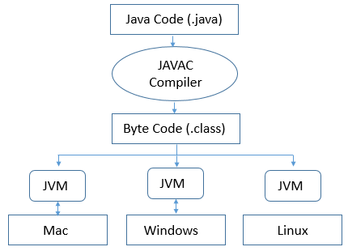
Platform Independent :

Slide 6
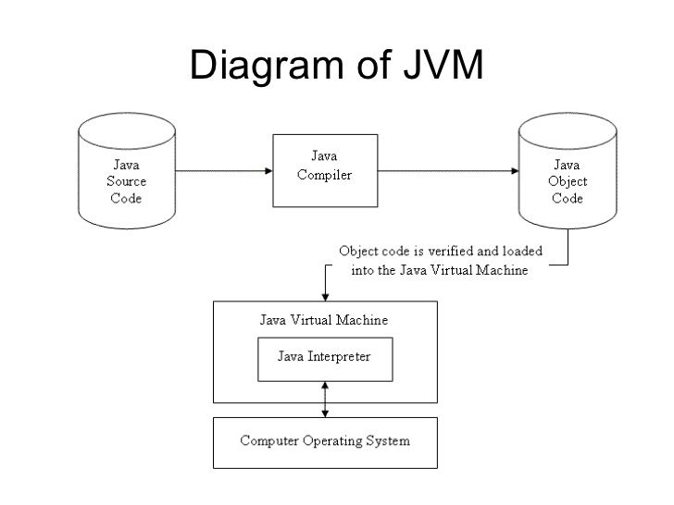

Slide 7
Object Oriented Programming
“Class” means a category of things
A class encompasses with variables and methods.
“Object” means a particular item that belongs to a class
Also called an “instance”
For example, consider the following line:
String s1 = “Bangladesh”;
Here, String is the class, s1 is an instance variable of class String.
To access any content of a class we need to create an object of that class and everything in java treated as belongs to a class.

Slide 8
Object Oriented Programming
There are three basic principles beyond OOP.
Encapsulation.
Inheritance.
Polymorphism.
Encapsulation is the mechanism that binds together code and the data it manipulates, and keeps both safe from outside interference and misuse.
Inheritance is the process by which one object acquires the properties of another object.
polymorphism means ability to have many different form. “One interface, multiple methods”.

Slide 9
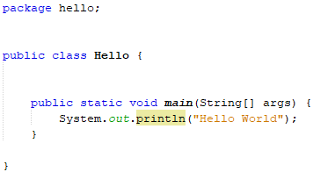
Simple Java Program
main method must declare,
public: to get access to other command line interface instructions.
static : to get access without creating any instance.
void : main do not return any value.

Slide 10
Data types, Variables and Arrays
Java is strongly typed language
Every variable has a type, every expression has a type, and every type is strictly defined. The Java compiler checks all expressions and parameters to ensure that the types are compatible.
The Primitive Types
Java defines eight primitive types of data: byte, short, int, long, char, float, double, and boolean.
These can be put in four groups.
Integers : byte, short, int, long.
Floating point numbers : float, double.
Characters : char.
Boolean : boolean. Value can be just true or false.

Slide 11
Data types, Variables and Arrays
Incompatible type casting
(target-type) value
(float) (4*5)/2
Type | Width | Data Range
Byte | 8 bit | -128 to 127
Short | 16 bit | –32,768 to 32,767
Int | 32 bit | –2,147,483,648 to 2,147,483,647
Long | 64 bit | –9,223,372,036,854,775,808 to 9,223,372,036,854,775,807
Float | 32 bit | 1.4e–045 to 3.4e+038
Double | 64 bit | 4.9e–324 to 1.8e+308
Char | 16 bit | 0 to 65,536

Slide 12
Operator
Arithmetic Operator Bitwise Operator
Assignment Operator
Operator | Operator
+ | +=
- | -=
* | *=
/ | /=
% | --
++
Operator | Action
~ | Bitwise NOT
& | Bitwise AND
| | Bitwise OR
^ | Bitwise XOR
>> | Bitwise SHIFT right
<< | Bitwise SHIFT left
Operator | Action
= | Assign value

Slide 13
Operator
Logical Operator Relational Operator
Ternary Operator
Operator | Action
&& | Logical AND
|| | Logical OR
== | Equal to
!= | Not equal to
?: | Ternary if-then-else
Operator | Action
> | Greater than
< | Less than
>= | Greater or equal to
<= | Less or equal to
Operator | Action
?: | If-then-else

Slide 14
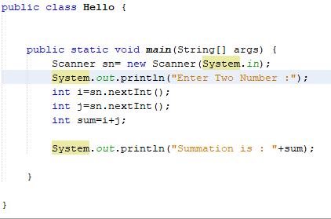
Input/output :

Slide 15

Input/output (Contd.):

Slide 16
Control Statement
There are three control statement in java,
Selection statement.
If
Switch
Iteration statement.
While
Do-while
For
For-each
Jump statement.
Break
Continue

Slide 17
Control Statement(Selection)
If-else
if(condition) statement 1
else statement 2
Nested If-else
if(condition)
{
if(condition) statement 1
else statement 2
}
Else
{
if(condition)
.
.
}

Slide 18
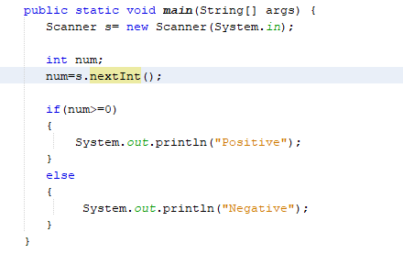
Control Statement(Selection)

Slide 19
Control Statement(Selection)
Task 01 :
WAP in java to determine a given number is even or odd

Slide 20
Control Statement(Selection)
Else-if ladder/chain
if(condition) statement 1
else if(condition) statement 2
.
.
.
else statement
Switch
switch(Expression)
{
case 1:
statement1
break;
.
.
default: statement
}

Slide 21
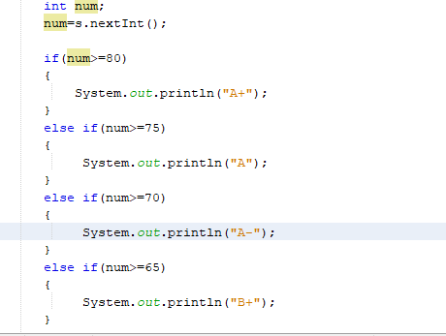
Control Statement(Selection)

Slide 22
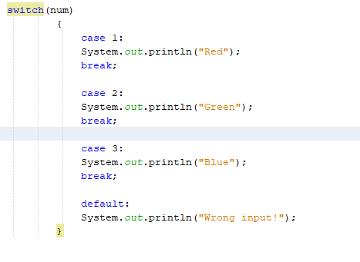
Control Statement(Selection)

Slide 23
Control Statement(Selection)
Tasks:
1) WAP in java to determine the grade of a given number
2) WAP in java to determine given char is vowel or consonant

Slide 24
Control Statement(Iteration)
For
for(initialization; condition; update)
{
//body
}
For-each
for(type itr_var: collection)
{
//body
}
For example
int num[]={10,20,30};
for(int x: num)
{
Sum+=x;
}

Slide 25
Control Statement(Iteration)
While
initialization
while(condition)
{
//body
update
}
Do-While
initialization
do {
//body
update
} while(condition);

Slide 26
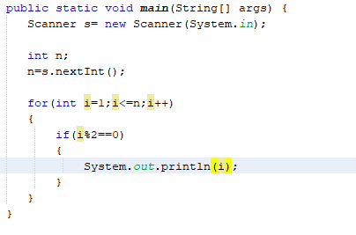
Control Statement(Iteration)

Slide 27
Control Statement(Iteration)
Tasks:
WAP in java to print all odd number from 1 to n.
WAP in java to find the factorial of a given number.

Slide 28
Control Statement(Jump)
Break
Break cause immediate termination of execution of a iterative statement.
Level Break
A level break cause immediate termination of execution of a program portion and put control to a portion after that level. For example
start:{
stop:{
if (…)
break start;
}System.out.println(“will not executed”);
}

Slide 29
Control Statement(Jump)
Continue
Continue causes iterative statement to continue by skipping residual portion of program.
Level Continue
A level continue causes to repeat execution of a program portion by skipping residual portion. For example
start:{
stop:{
if (…)
continue stop;
System.out.println(“will not executed”);
} }

Slide 30
Thanks

